Slide 1



Internet of things
Project presentation
8th semester

Slide 2
Team members
Khyati Patel (201806100110053)
Sourabh Singh (201806100110069)
Viraj Thakkar (201806100110094)
Vishwa Chaturvedi (201806100110128)

Slide 3

Table of content
Sr. No | Topic
1. | Introduction
2. | Problem Definition
3. | Proposed Solution
4. | How it works
5. | Measuring Psychological State
6. | Hardware Description
7. | Benefits

Slide 4
Introduction

Slide 5
Introduction
As the world is moving towards more advanced digital era, maintaining a health is a must. As far as the physical and mental health is concern, humans have gained enough technological advancement through which they can monitor their health. There are numerous technical and smart devices are available in the market that can smartly take preventive health measure.
The issue lies with other domestic and speechless animals who can’t speak and express their expression. Even though the cost of performing a medical healthcare check-up is quite expensive as compare to individual human.

Slide 6
Problem definition

Slide 7
Problem definition
Currently as of the time of pandemic, Surveillance of animal diseases and animal health information management has been trembled due to restriction of transportation.
Due to lack of proper information, it affects the strategic approach for providing services across the country. (Services like food transportation, medical services, shelter providers)
Lack of animals information management system also leads to poor livestock management and network system.
The main issue lies with the time and cost of travelling from one location to another for a Veterinarian (Animals Doctor) who have relatively less as compare to number of animals present in that region ( Approximately 37 veterinarian and 16 Animal health care in Surat)
And many more……

Slide 8
Proposed solution

Slide 9
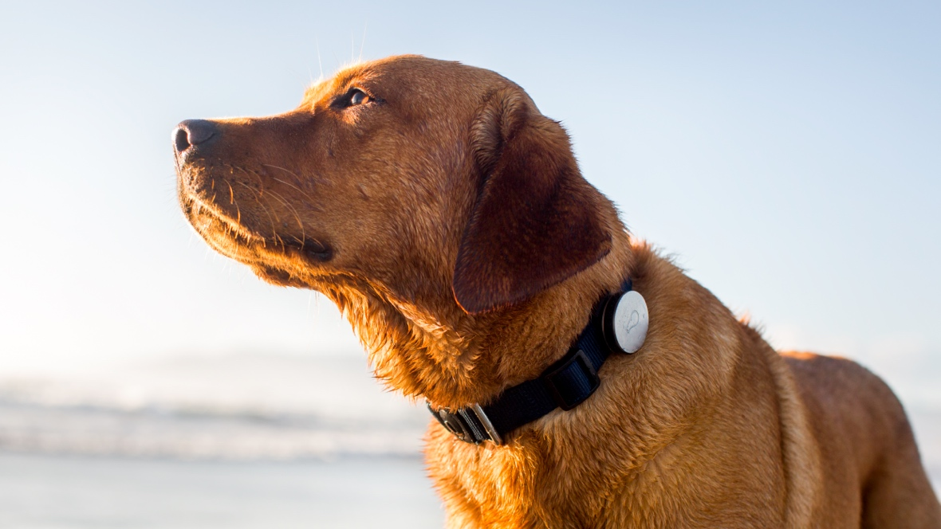
Proposed Solution
A Smart band for animal just like one made for human can collectively solves all the problems defined in the previous slides.
With the advancement of the technology and sensors available in the market, the data can be collected from the animals without the need of human touch and the data can be processed virtually and the best course of action can be taken by the owner on the basis of output evaluated by the computer.
Altogether, a wireless local area network can be set in order to collect the data from multiple smart band and processing can be done in batch, which can point out the irregularity in their physical and mental behaviour.

Slide 10
How it work ?

Slide 11
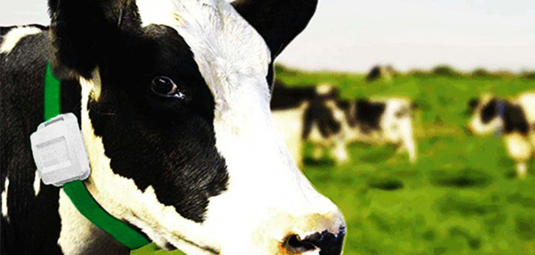
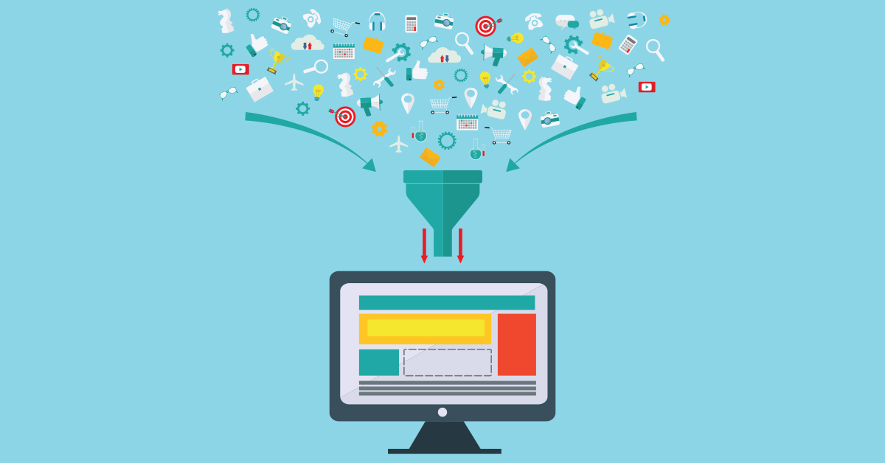
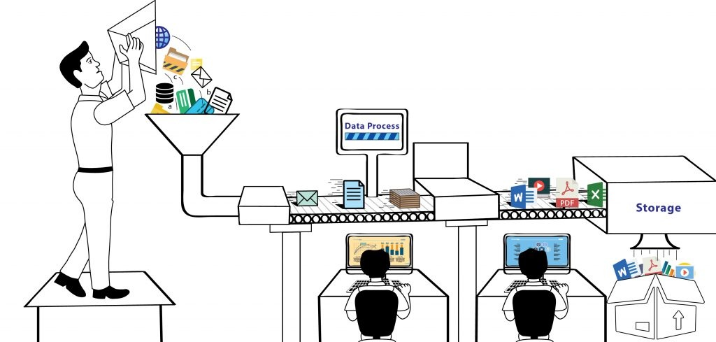
How it works ?
Attaching the device
Sensing the data
Data processing
The device is embedded with multiple sensors with inbuilt battery and storage capacity.
The smart band will sense the data from the biological host and stores them in the memory.
Once the data has been collected and stable internet connection has been made, the data will be uploaded on the internet for processing the data.

Slide 12
Measuring psychological state

Slide 13
What is required to measure the psychological state ?
Whenever a living organism undergoes a psychological change or mental change, then some physical changes can be noted. Although these changes are seems to be minor, but they surely have huge impact on the mental and physical change.
When an animal suffer or experiences a pain then the following changes are noted through their physical state:
Change in Blood Pressure
Change in Electrodermal activity (Electrical conductivity in sweat)
Excess Rise or Fall of Heart Beat
Change in Oxygen Level
Electrical Activity in Brain

Slide 14
Hardware description

Slide 15
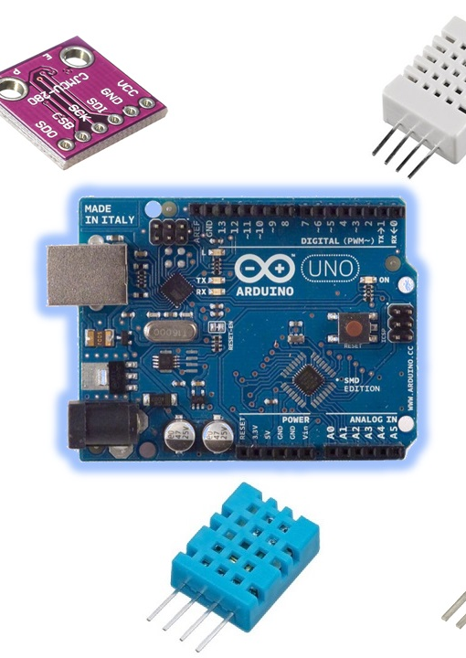
Hardware description
As the smart band is made by embedding multiple independent sensor. The following are the sensors that would collect the data from the host or subject :
ADXL 335 (3-axis accelerometer)
MAX30100 (Pulse Oximeter and Optical Heart rate sensor )
AD8232 ECG Sensor (Measure electrical activity in the brain and body)
NEO-6m (GPS)
GSR Sensor (Electrodermal Sensor)

Slide 16
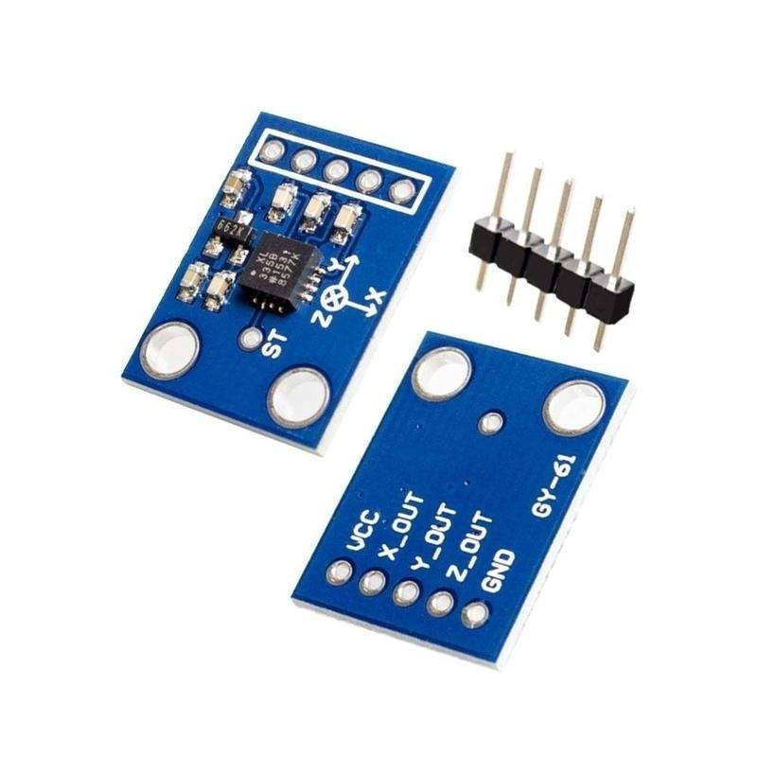
ADXL 335 (3-axis accelerometer)
An accelerometer is an electromechanical device that will measure acceleration force. It shows acceleration, only due to cause of gravity i.e. g force. It measures acceleration in g unit. Accelerometer can be used for tilt-sensing applications as well as dynamic acceleration resulting from motion, shock, or vibration.

Slide 17
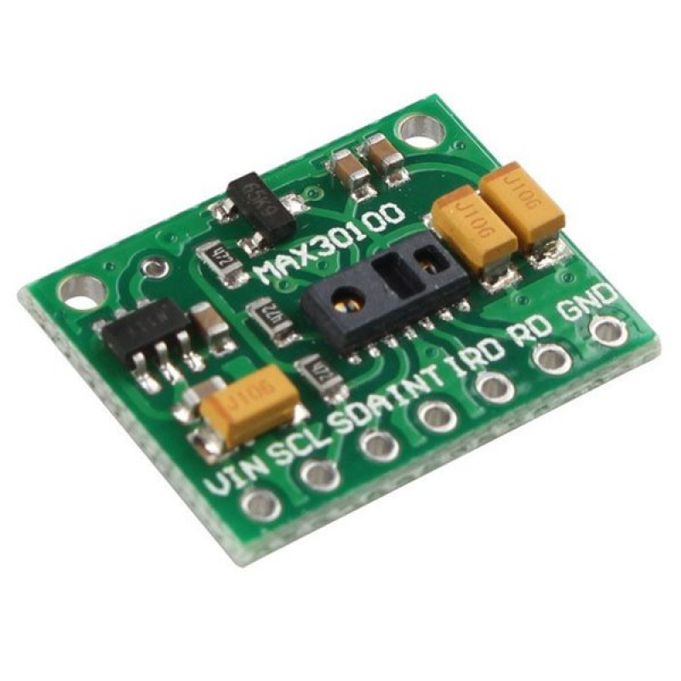
MAX30100 (Pulse Oximeter and Optical Heart rate sensor )
MAX30100 is an integrated pulse oximeter and heart-rate monitor sensor solution. It’s an optical sensor that derives its readings from emitting two wavelengths of light from two LEDs – a red and an infrared one – then measuring the absorbance of pulsing blood through a photodetector. This particular LED colour combination is optimized for reading the data through the tip of one’s finger.

Slide 18
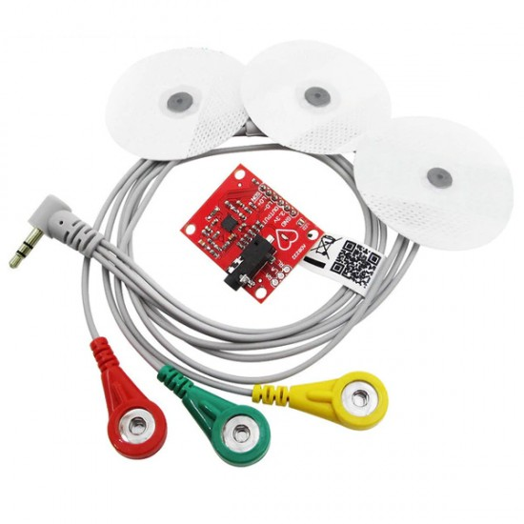
AD8232 ECG Sensor
The AD8232 ECG sensor is a commercial board used to calculate the electrical movement of the human heart. This action can be chart like an Electrocardiogram and the output of this is an analog reading. Electrocardiograms can be very noisy, so to reduce the noise the AD8232 chip can be used. The working principle of the ECG sensor is like an operational amplifier to help in getting a clear signal from the intervals simply.

Slide 19
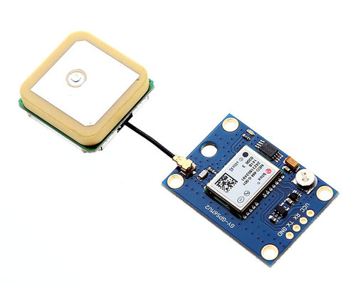
NEO-6m (GPS)
As indicated, the GPS modules are based on the NEO-6M GPS engine. The type number of the NEO-6M is NEO-6M-0-001, and its ROM/FLASH version is ROM 7.0.3 (PCN reference UBX-TN-11047-1). The NEO-6M module includes one configurable UART interface for serial communication, but the default UART (TTL) baud rate here is 9,600. Because the GPS signal is right-hand circular-polarized (RHCP), the style of the GPS antenna will be different from the common whip antennas used for linear polarized signals. The most popular antenna type is the patch antenna.

Slide 20
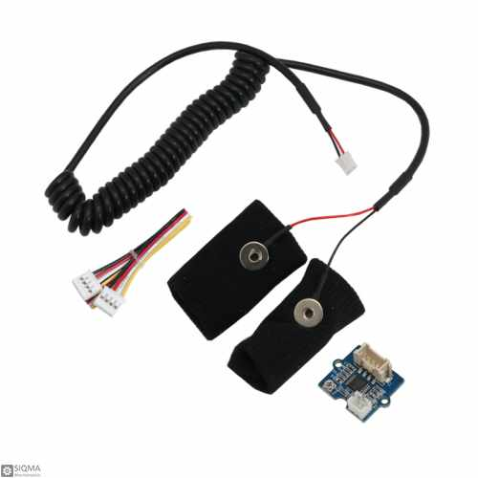
GSR Sensor (Electrodermal Sensor)
GSR stands for galvanic skin response, is a method of measuring the electrical conductance of the skin. Strong emotion can cause stimulus to your sympathetic nervous system, resulting more sweat being secreted by the sweat glands. Grove - GSR allows you to spot such strong emotions by simple attaching two electrodes to two fingers on one hand.

Slide 21
benefits

Slide 22
Technical Benefits
Data Harvesting
Real time health monitoring
Providing the service to NGO and government bodies by virtually sharing the data
Clustering the data to predict the area where more technical help support is needed

Slide 23
Business Benefits
Harvesting the data can leads to crucial insights that can help an individual or organization to expand it’s business.
Companies that’s produces the animal goods like animal foods, animal medical supply, medical tool kit etc can gain benefit from these product as they don’t have to conduct the survey for manufacturing the goods.
Dairy product supplier, poultry product supplier, non-food supplier and meat and meat product supplier can gain insight that from where they can get maximum and good quality of products.

Slide 24
Benefits
Animals with good physical and mental state always produces a quality raw goods e.g. a healthy cow always produces good quality milk. Most of the dairy products are based on the animals so the by products we get from the milk like
Cheese
Butter
Yogurt
Cream
Will be of good quality as well.

Slide 25
Thank You

Slide 26
Questions ??

